Slide 1

V5
24V items
12V items
5V items
Left Motor
Right Motor
Dome Motor
Left Speaker
Right Speaker
L+
R+
L-
R-
M1A
M1B
M1A
M1B
M1
M2
XBOX 360 controller
M1
M2
S2 (Rx2)
USB Port, via USB Host shield
Sabretooth motor controller
(foot drives)
Syren Motor controller (dome drive)
Arduino Mega
M1A
M1B
M2A
M2B
S1
Pin1
D50
S2
S2 (TX2)
D51
S1 (RX1)
D53
S1 (TX1)
3.5mm jack
Amp
L+
GND
L-
GND
R+
R-
MP3 Trigger
Dome LEDs
3.5mm jack
RX
CS
CLK
DIN
S1
B+
B-
S2
B+
B-
VIN
GND
12V
GND
VCC
GND
VIN
GND
24V +ve bus
Converter
24V->-12V
GND
12V +ve bus
Converter
12V->-5V
GND
GND
GND
5V +ve bus
+ve
+ve
+ve
+ve
+ve
+ve
+ve
24V
12V
+ve
+ve
12V
5V
+ve
+ve
+ve
-ve
+ve
+ve
24 V Battery
On/Off Switch
Common ground items
GND Bus
GND
GND
GND
GND
GND
GND
GND
GND
GND
GND

Slide 2
V4
24V items
12V items
5V items
Left Motor
Right Motor
Dome Motor
Left Speaker
Right Speaker
DEPRECATED
L+
R+
XBOX 360 controller
L-
R-
M1A
M1B
M1A
M1B
M1A
M1B
Sabretooth motor controller
(foot drives)
Syren Motor controller (dome drive)
S2 (Rx2)
USB Port, via USB Host shield
Arduino Mega
S1 (RX1)
S2 (Rx2)
Pin1
D50
S1 (TX1)
S2 (TX2)
S2 (TX2)
D51
S1 (RX1)
D53
S1 (TX1)
3.5mm jack
Amp
L+
GND
L-
GND
R+
R-
MP3 Trigger
Dome LED
3.5mm jack
RX
CS
CLK
DIN
M1B
M2A
M1B
M1A
B+
B-
M2B
M1A
B+
B-
VIN
GND
12V
GND
VCC
GND
VIN
GND
GND
Converter
24V->-12V
GND
Converter
12V->-5V
GND
GND
24V
12V
12V
5V
24V
GND bus
24V +ve bus
12V
GND bus
12V +ve bus
5V
GND bus
5V +ve bus
-ve
+ve
-ve
+ve
-ve
+ve
-ve
+ve
-ve
+ve
-ve
+ve
-ve
+ve
-ve
+ve
-ve
+ve
-ve
+ve
-ve
+ve
+ve
-ve
+ve
+ve
24 V Battery
On/Off Switch
GND Bus
-ve
-ve
-ve
-ve

Slide 3
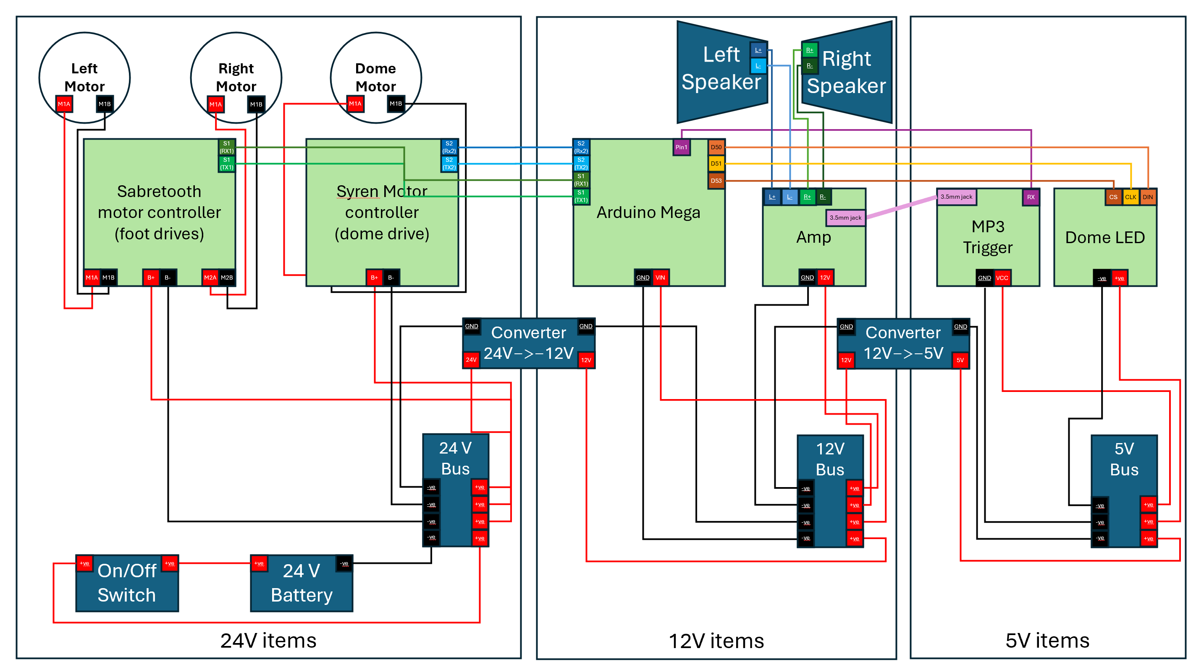
V3
DEPRECATED

Slide 4
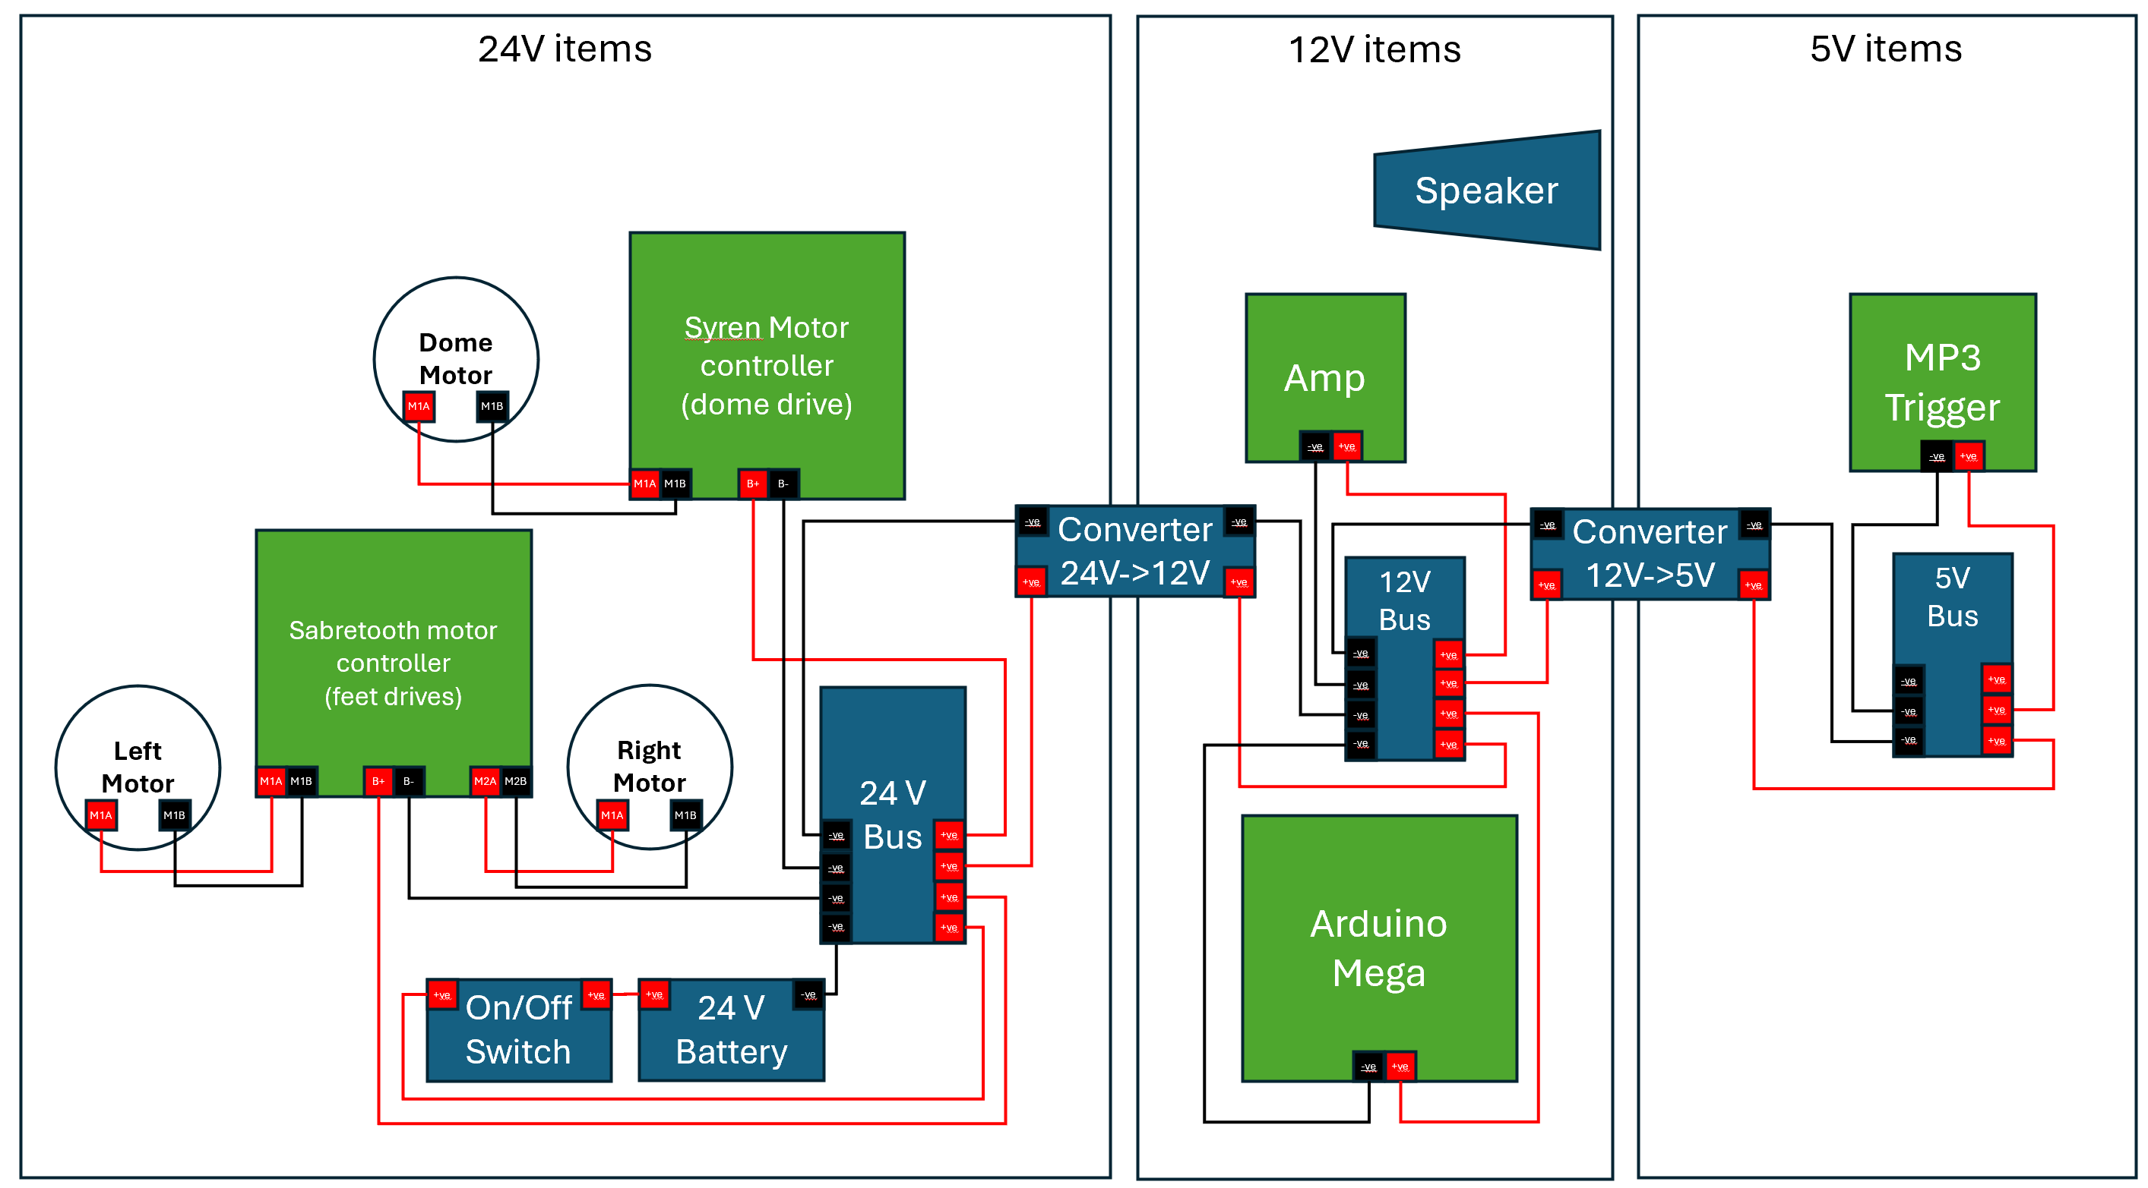
V1+V2
DEPRECATED

